Slide 1
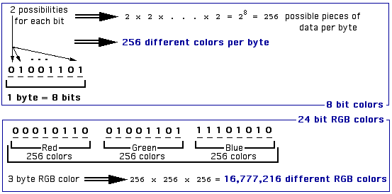
RGB Colors – Red, Green, Blue
256 color shades per byte
One byte for each of Red, Green, Blue
Almost 16 million different RGB colors

Slide 2
The 256 shades of each RGB color component can be represented as color saturation levels from 0 to 255.
The higher the color saturation, the brighter the color gets. Each color component (Red, Green, or Blue) works like this.
This lists just a few of the 156 different possible shades.
0 black – no saturation
. .
.
51 dark – low saturation
.
.
.
102 medium-dark – medium-low saturation
.
.
.
153 medium-bright – medium-high saturation
.
.
.
204 bright – high saturation
.
.
.
255 brightest – full saturation

Slide 3
rgb()notation lists saturation levels of each color component in order.
Pure colors contain 0 saturation of the other two colors.
Equal saturations of all three color components gives Grey.
Equal Red and Blue (but no green) gives roughly Purple.
Black is no saturation of any of the colors: rgb(0,0,0)
White is full saturation of all colors: rgb(255,255,255)

Slide 4
Surprising? Black: rgb(0,0,0) White: rgb(255,255,255)
No light in inter-stellar space - blackness. White light from the sun – full spectrum of all colors.
RGB colors combine like visible light.
Light is additive – add more color saturation, it gets brighter.
Paint is subtractive – add more paint colors, it gets darker.

Slide 5
Most developers use Hexadecimal (Hex) notation.
Hexadecimal refers to base 16 numbers.
rgb(204,204,204) <------ both represent the same light grey ------> #CCCCCC
CC in Hex is equivalent 204, so the two colors are the same.
Binary numbers base 2 -- only 2digits -- 0,1
Base 10 numbers – 10 digits -- 0,1,2,3,4,5,6,7,8,9
Base 16 (hex) numbers – 16 digits -- 0,1,2,3,4,5,6,7,8,9,A,B,C,D,E,F
A represents 10, B represents 11, . . . , F represents 15.
Each place requires a single digit, so you can't use 11, for example, because that's 2 digits.

Slide 6
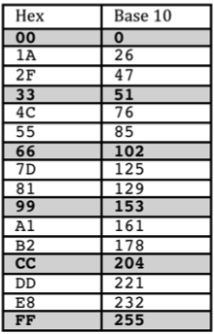
Why is Hex useful in Computer Science?
A byte can always be represented as only two Hex digits!
The table to the right only lists a few out of
the 256 total shades (could be R, G, or B).
The boldfaces ones (00,33,66,99,CC,FF)
are called Web Safe Shades.
A Web Safe Color uses only Web Safe Shades.
#CC33FF is Web Safe -- #CCB2FF is not.
Using Web Safe colors was necessary in the
early days of the Web, because old computer
screens had limited color capabilities.
Now you can freely use any of the almost 17 million RGB colors!

Slide 7
These tables list identical colors, but use different notations.
Most developers use Hex like below.
These tables show mostly Web Safe Colors, only as a convenience.

Slide 8
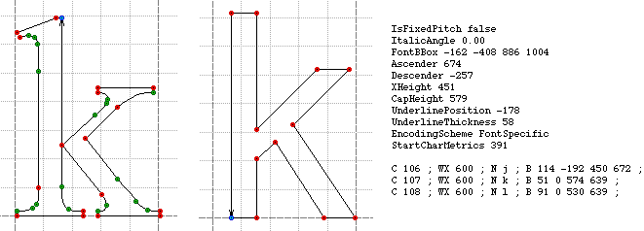
Fonts for computers are files containing technical specs that show exactly how to draw the characters.
Serif font Sans-Serif font
Some common fonts come with your operating system. When you install software like Word, it might install other fonts.
You can go to free online font libraries and grab all sorts of weird fonts.

Slide 9
When you specify a font to be used in your Web page, remember that your Web page travels to other people's computers to be rendered by their browsers.
If you specify a strange font in your page (e.g. funky freaky gothic) that other people do not have on their computers, their browsers will simply ignore it and use a default font.
There is a way your page can tell a Web browser to actually download a funky font on-the-fly, but that is beyond the scope of this lesson.
W3Schools lists some Web Safe Fonts that everyone's computer should have. Thus they are safe to use in Web pages.
http://www.w3schools.com/cssref/css_websafe_fonts.asp
Not everyone even has Microsoft Word installed, so it's not even safe to choose funky fonts from the long list of fonts it will show you.

