Slide 1
Adding markup instructions to documents is not new. Before computers, authors would make annotations by hand in their written or typed documents. These annotations described what the text should look like when it was typeset. The markup instructions might indicate what words should be bold or italic, or what fonts to use for certain sections.
With computer documents, the markup instructions are embedded into the binary files. The rendition of a file is what you see when computer software reads the file and interprets the markup instructions. The markup instructions in the file tell the software how to render the text in the file onto the computer screen.

Slide 2
A word processor, such as Microsoft Word, uses a custom markup language.
But you only see only the rendition, not the underlying markup language. For this reason, word processors are sometimes called WYSIWYG Editors (What You See Is What You Get).
Word Perfect, an old word processor, had an option where it would show you the nature of the markup it was inserting.

Slide 3
HTML - HyperText Markup Language
Unlike with word processors, humans can directly type HTML markup instructions into a plain text file.
Here is what some old-school* HTML might look like for the word processor formatting from the previous slide. *font is now controlled with Cascading Style Sheets (CSS) rather than pure HTML.
<font size="14" face="Swing">
<b>Bryan Moore</b><br>
</font>
<font size="12" face="Textile">
1234 Sunset Ave<br>
WallaWalla, WA 12345<br>
(123)123.4567<br>
</font>
The rendition of an HTML file is called a Web page.

Slide 4
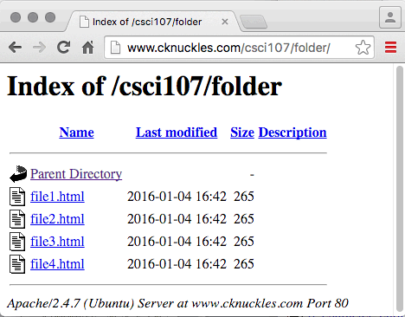
Hiding Directory Listings
When a Web browser requests a folder instead of a particular file name, the server may send you a generic listing of all files in the directory .
If there is a file named exactly index.html in the directory, then that page will load into the browser instead of a directory listing.
The special name default.html also works on some servers.

